Slide 1
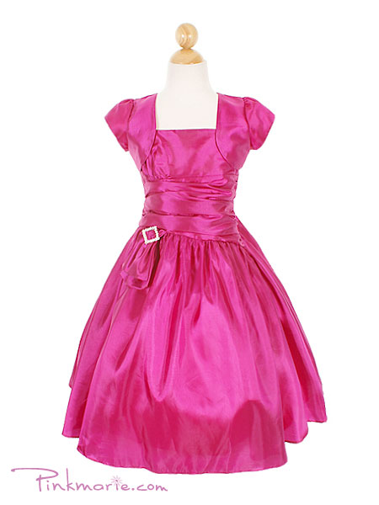
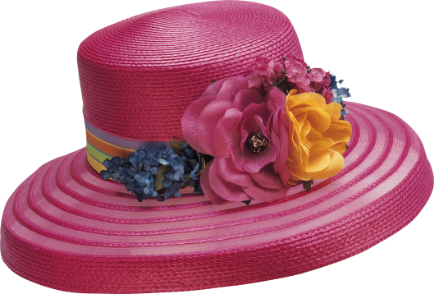
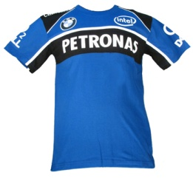
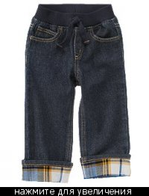
Shopping for clothes

Slide 2
Match
There is no bad weather, there are only bad clothes.
Do not judge a water – melon by its rind and a man by his clothes.
Не суди об арбузе по корке, а о человеке по платью.
Не бывает плохой погоды, бывает плохая одежда.

Slide 3
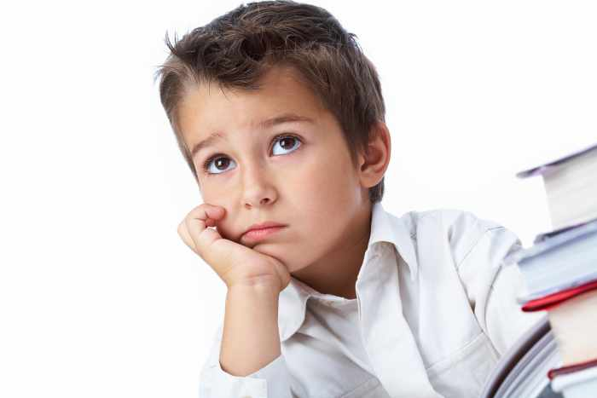
По чему человека всегда встречают,
но никогда не провожают?

Slide 4
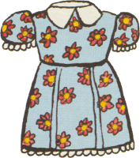
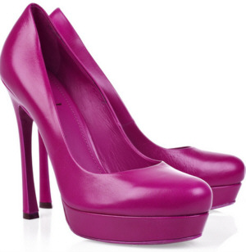
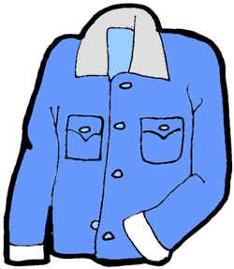

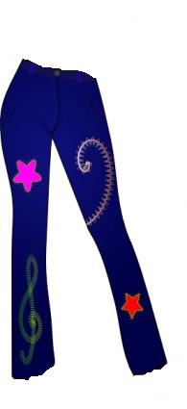
ОДЕЖДА
“CLOTHES”

Slide 5
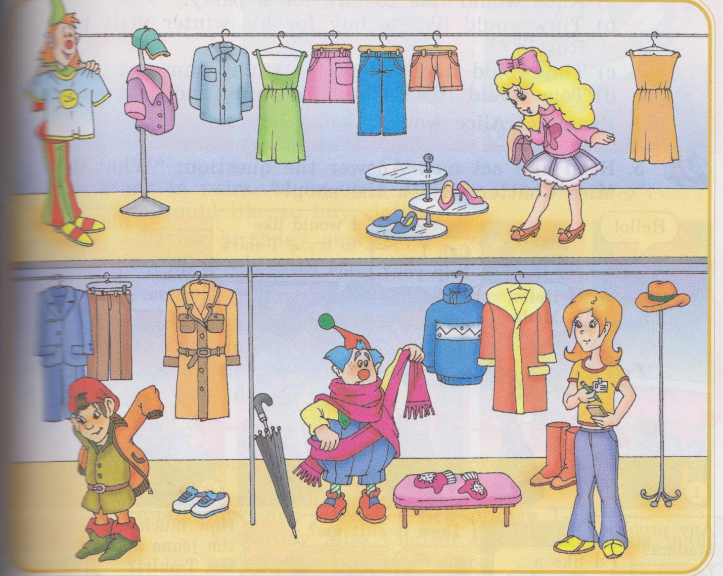
Listen and repeat

Slide 6
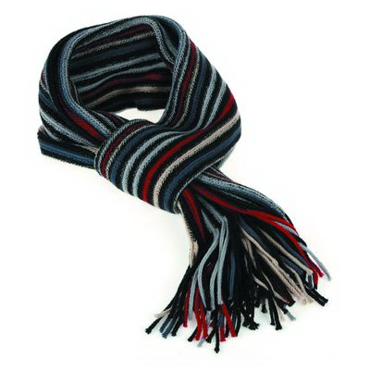
a scarf

Slide 7
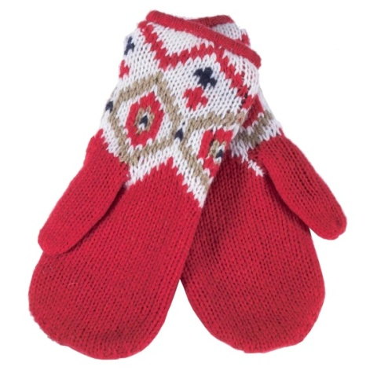
mittens

Slide 8
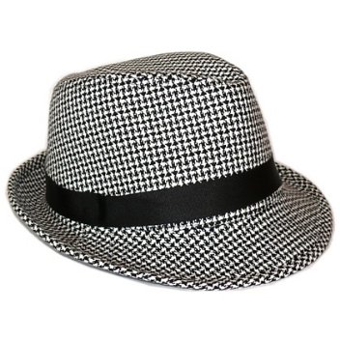
a hat

Slide 9
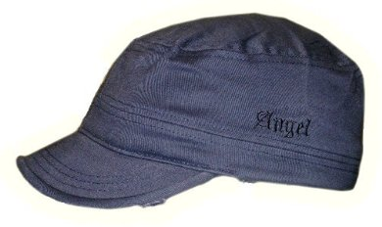
a cap

Slide 10
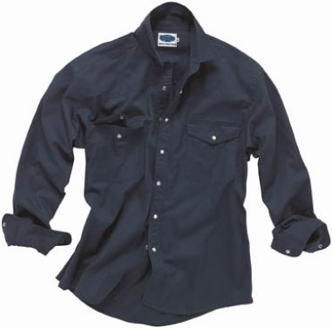
a shirt

Slide 11
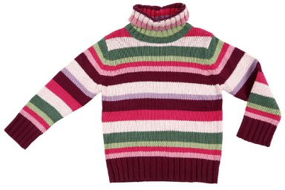
a sweater

Slide 12
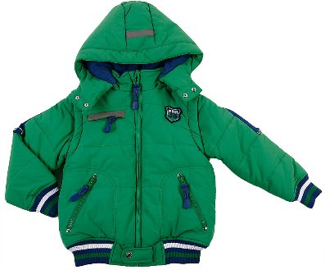
a jacket

Slide 13
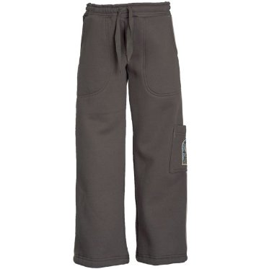
trousers

Slide 14
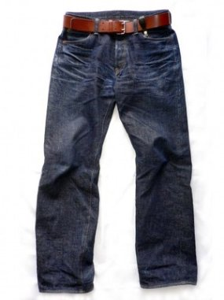
jeans

Slide 15
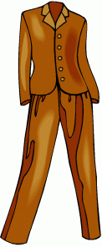
Suit

Slide 16
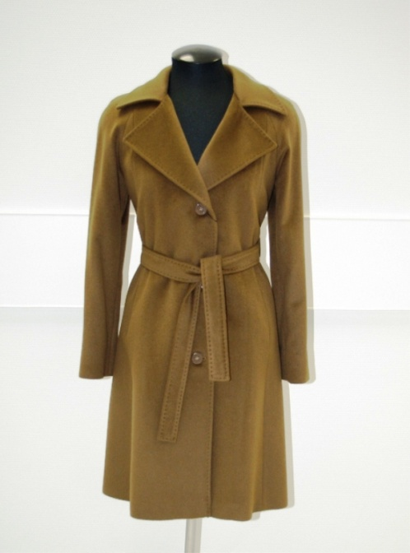
coat

Slide 17
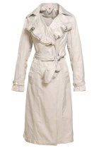
raincoat

Slide 18
dress

Slide 19
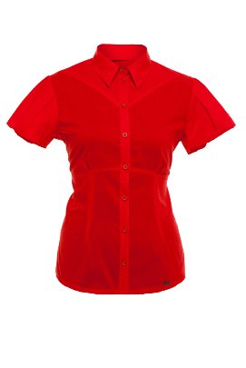
a blouse

Slide 20
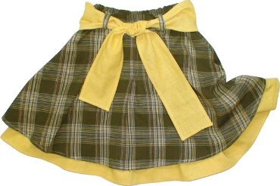
skirt

Slide 21
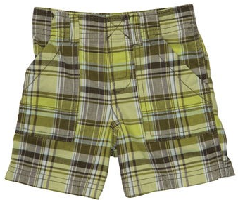
shorts

Slide 22
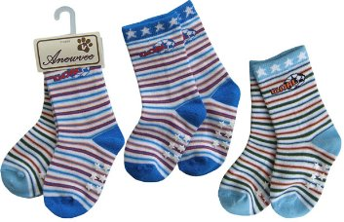
socks

Slide 23
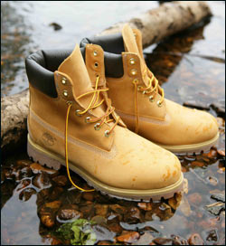
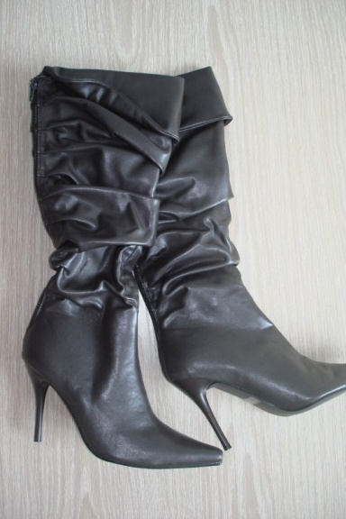
Boots

Slide 24
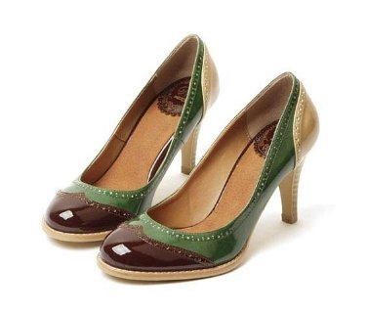
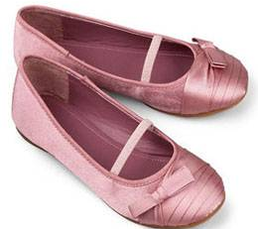
shoes

Slide 25
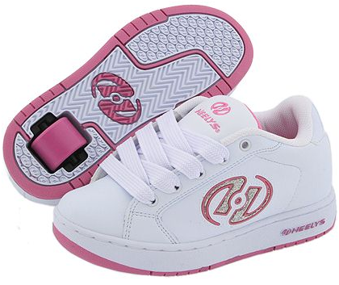
Trainers

Slide 26
Answer the questions
1. What would Alice like to buy?
2. What would Tim like to buy?
3. What would Tom like to buy?
4. What would Tiny like to buy?

Slide 27
Make a dialogue
What would you like to buy?
-I`d like to buy …

Slide 28


Slide 29
Shop assistant : Hello!
Client:: Hello!
A: Can I help you?
С: I would like to try a….and….
А: What colour?
С: ………., please.
А: Any problem?
С: I’d like a smaller size! Does it suit me?
A: It looks good
С:How much does it cost?
А:…..pounds .Here you are!
С:Thank you. Goodbye.
А: Goodbye!

Slide 30
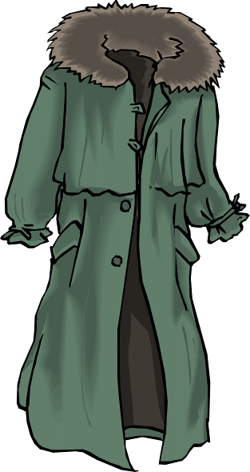

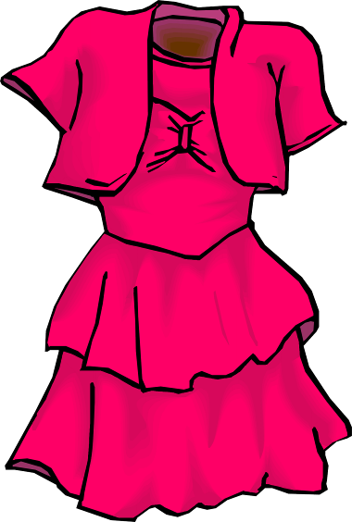
Проверь себя!
Example: t, e, s, h, o, c, l – clothes
1) a, t, c, o -
2) h, t, a –
3) e, r, d, s, s –

Slide 31
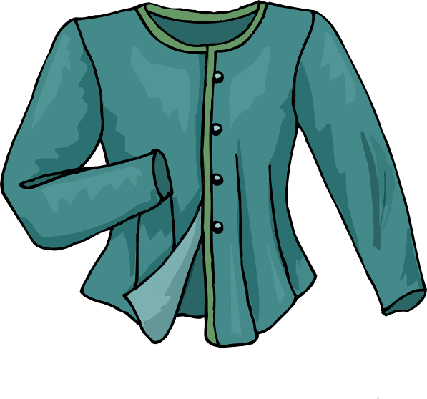
4) l, b, o, s, e, u –
5) t, m , i, t, e, n, s -
Score___/5

Slide 32

Продолжи предложение:
– Сегодня я узнал…
– У меня получилось …
– Было интересно…
– Было трудно…
– Я понял, что…

Slide 33
Goodbye!

